Slide 1
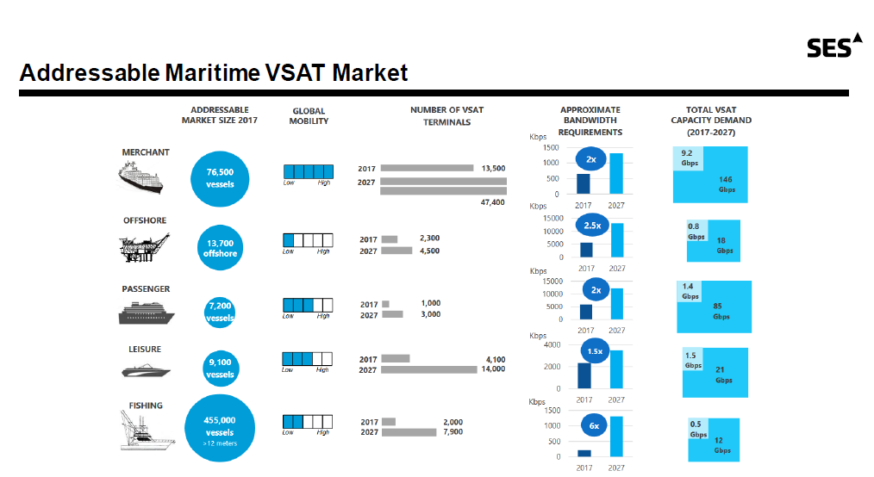
Source : SES

Slide 2
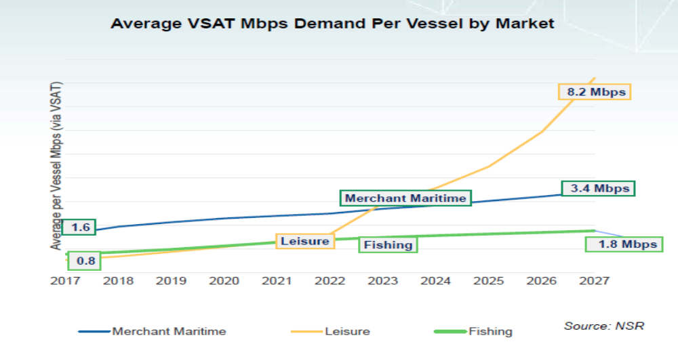
Bandwidth usage
VSAT based services continue to push the bandwidth up
Notes:
MSS is on a -2.6% CAGR and

Slide 3
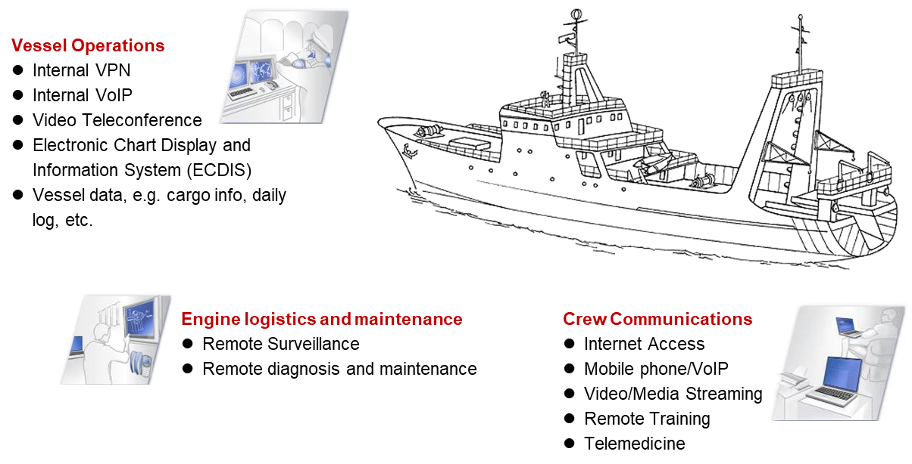
Modern Vessels communications solutions

Slide 4
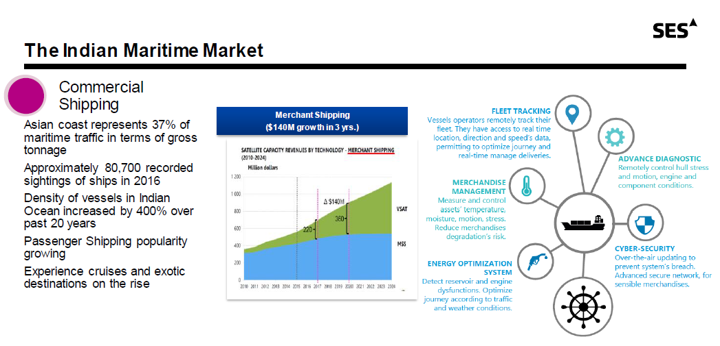
Source : SES

